Slide 1

QUESTION ANSWERING AND ENTITY RECOGNATION
NATURAL LANGUAGE PROCESSING

Slide 2
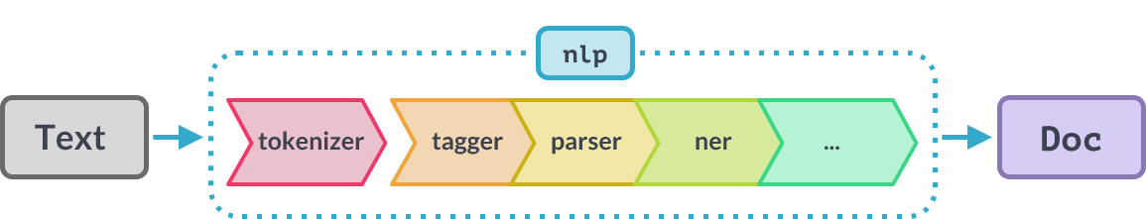
SPACY AND HUGGING FACE TRANSFORMER
Hugging Face Transformers functions provides a pool of pre-trained models to perform various tasks such as vision, text, and audio.
spaCy is a free, open-source library for advanced Natural Language Processing (NLP) in Python.

Slide 3
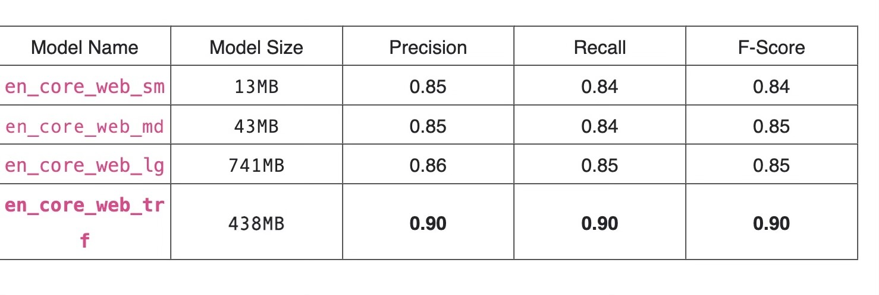
ENTITY RECOGNATION (There are a lot of other models that were fine-tuned on the same dataset. Here are few)
We'll be using two NER models on SpaCy, namely the regular en_core_web_sm and the transformer en_core_web_trf.
MODELS USED
PIPELINES USED (NER-TRANSFORMERS)
dslim/bert-base-NER”
xlm-roberta-large-finetuned-conll03-english"
roJean-Baptiste/roberta-large-ner-english”
PIPELINES USED (SPACY)
1. "en_core_web_sm” -NER
2. 'en_core_web_trf’ – ROBERTA BASE USING SPACY
CONCLUSION
The en_core_web_trf model performs much better than the previous ones.

Slide 4
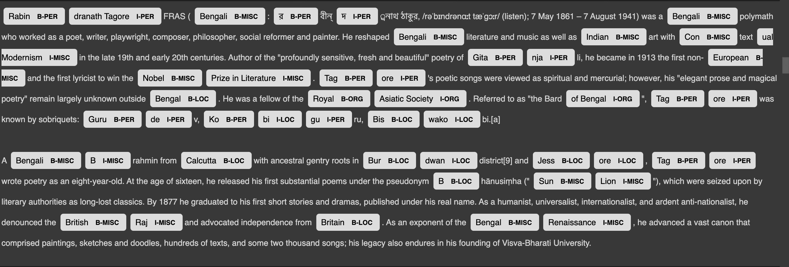
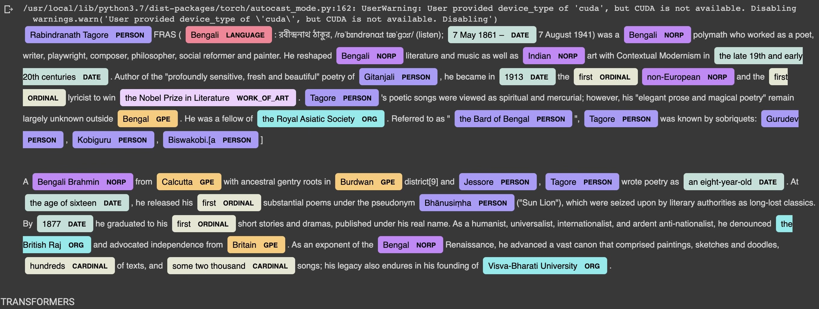
OUTPUTS
BASIC
OUTPUT
FINAL
OUTPUT

Slide 5
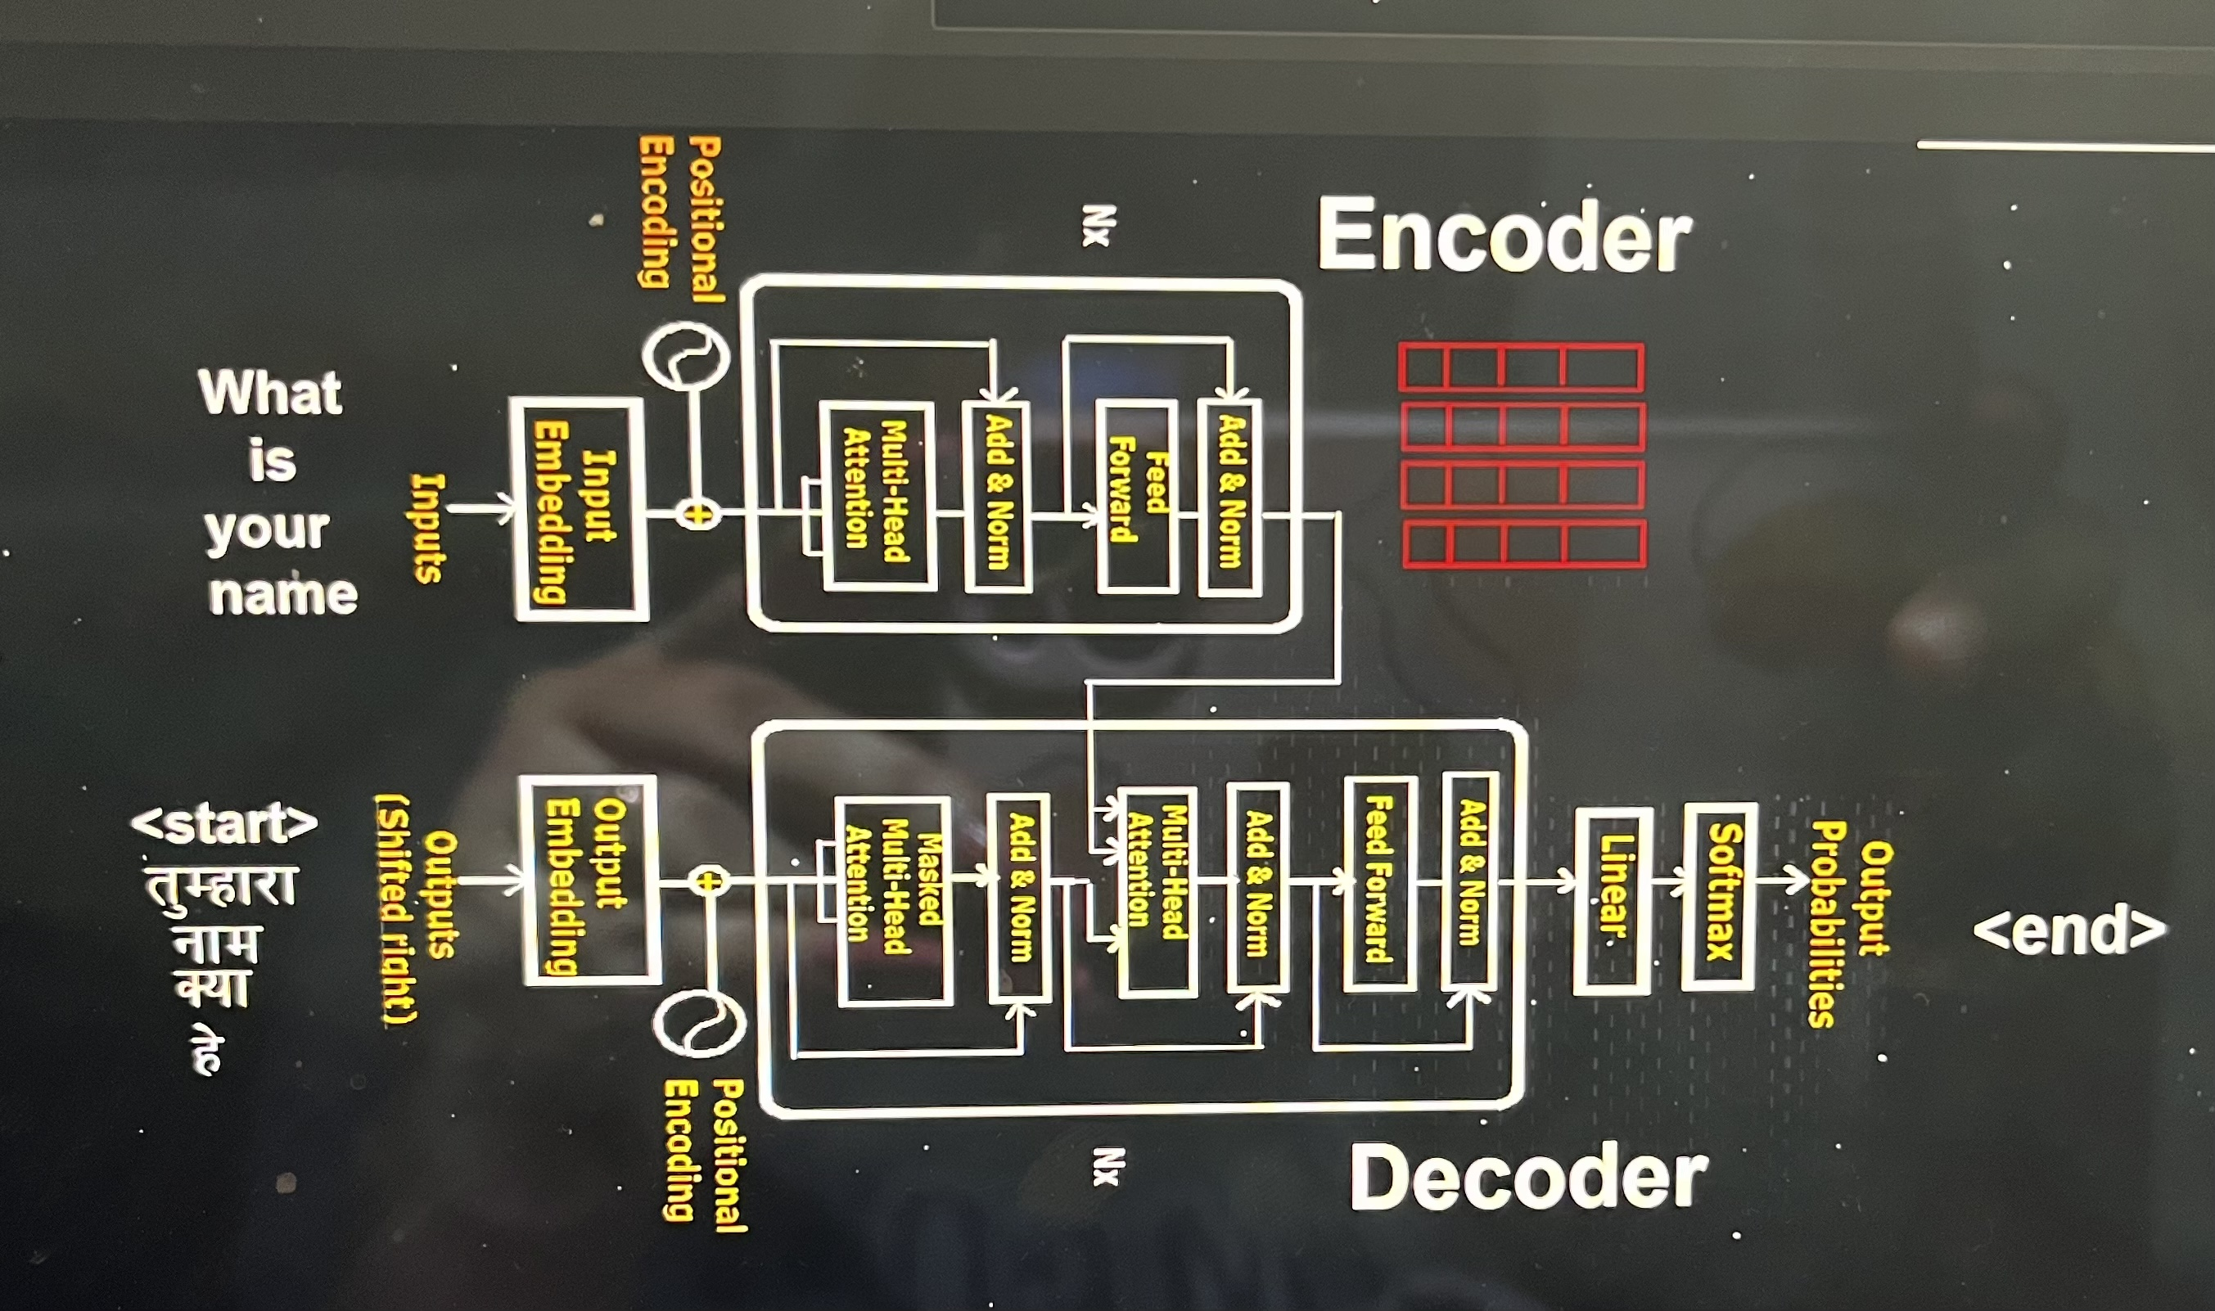
TRANSFORMER

Slide 6
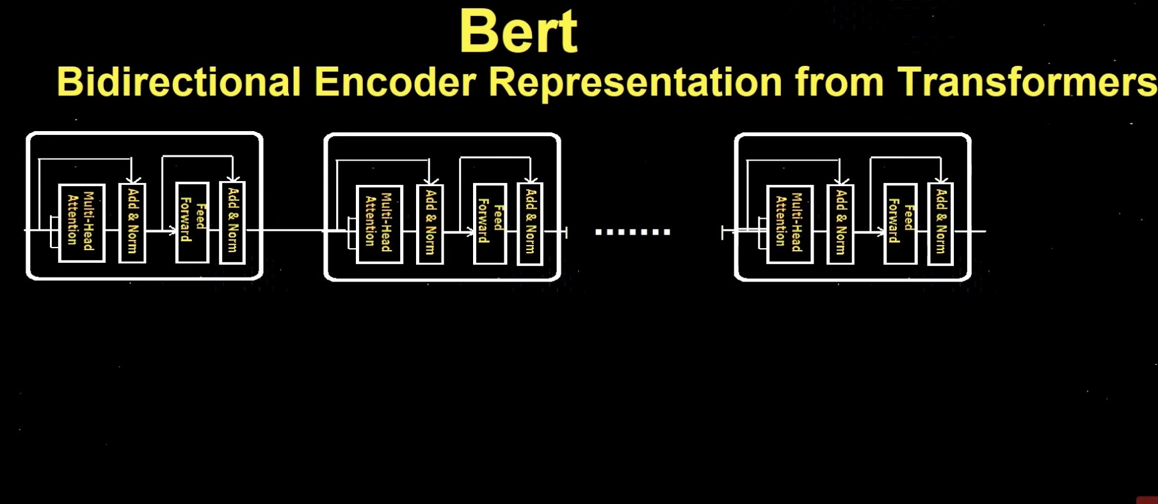
BERT

Slide 7
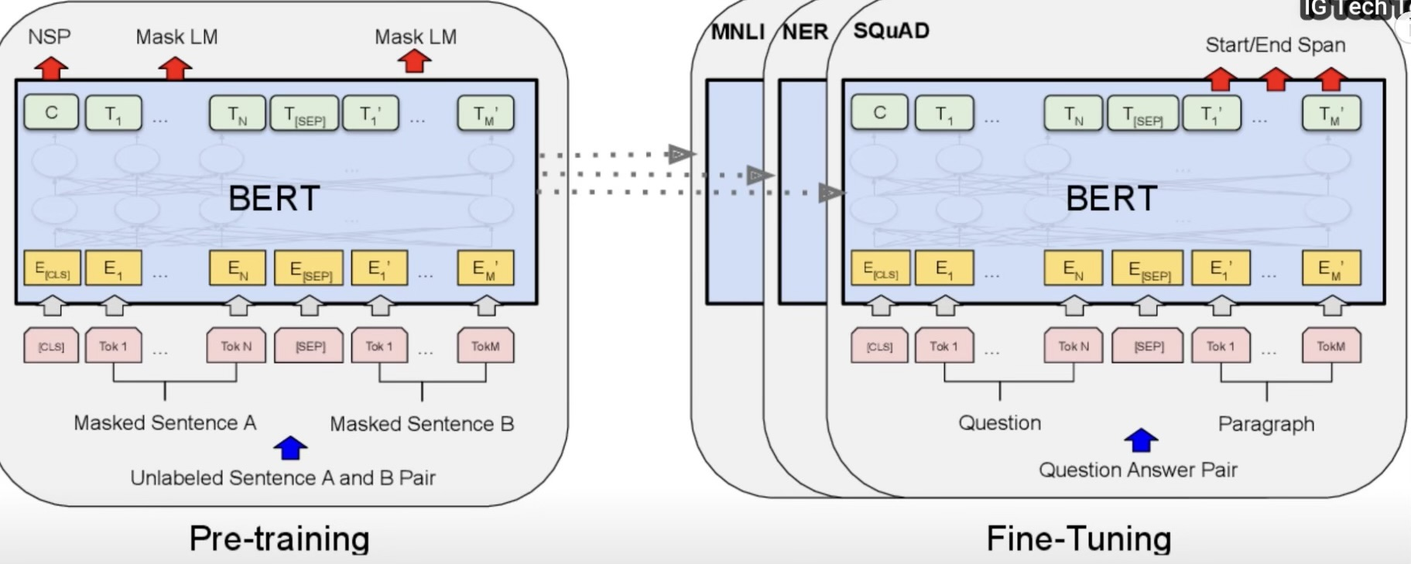
Phase of Bert

Slide 8
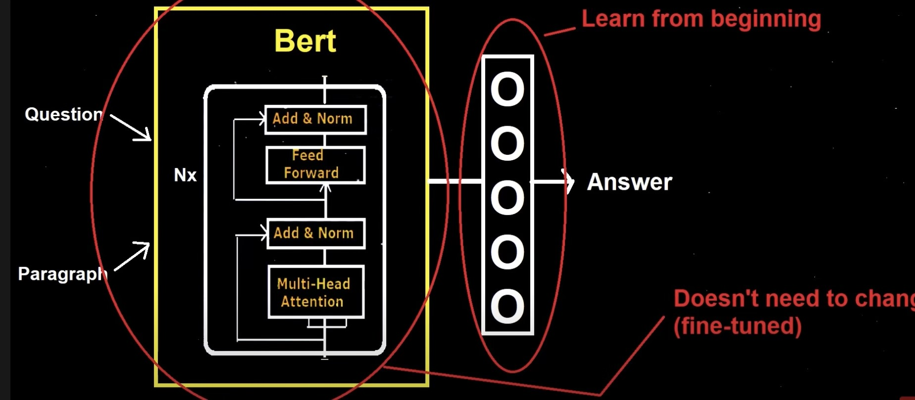
QUESTION ANSWER ARCHITECTURE

Slide 9
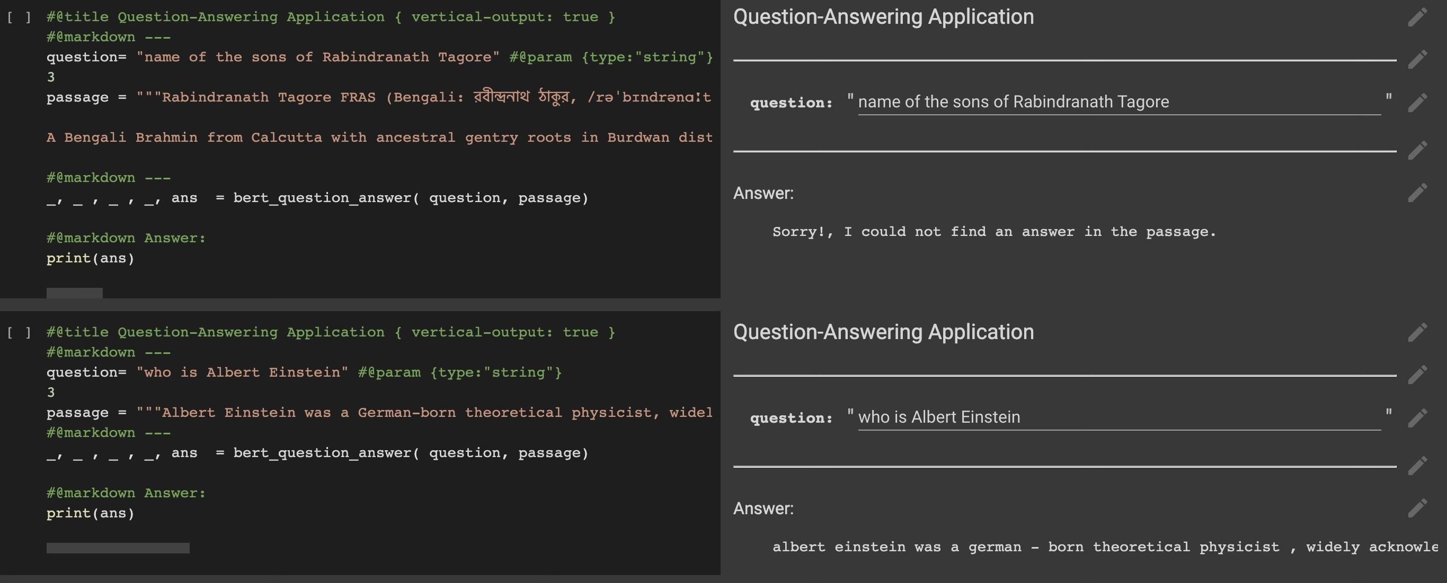
FINAL OUTPUT

Slide 10
FUTURE PERSPECTIVE
Named entity recognition (NER) allows you to quickly recognize significant aspects in a document, such as people's names, places, brands, and monetary values. When dealing with enormous datasets, extracting the major entities in a text can help sort unstructured data and uncover relevant information. What do the words mean in context? Who is doing what to whom? What companies and products are mentioned? Which texts are similar to each other?
The question answering model can have various usage in the future. One such use is visual question and answering where this model can be used to answer questions based on a picture or a scanned copy of a written document. This can be extremely helpful for visually impaired people
Also this can be used in the medical field to answer any questions people have related to any disease. For example during Covid this model was used to help people answer any questions related to COVID-19 and clear any misconceptions or questions they had. In the future as well this can be a very useful tool to help people know about any disease

